Slide 1
Exploring Dark Data with SQL Server 2016 and R Oliver Frost
Tuesday 6th June 2017

Slide 2
Thank you!

Slide 3
Today’s session
The R and SQL Server “stack”
Why R? UPDATE: Python!
DEMO – R inside SQL Server 2016:
Setting up
Executing scripts
DEMO – Dark Data with R and RevoScaleR:
What are the libraries for?
Explore, summarise and plot data
Predictive modelling and big data

Slide 4



Introductions and Background
Cognitive Neuroscience graduate (2015)
Microsoft SQL Server 2012 onwards 2014 and 2016
Microsoft R, open R and Python
Hadoop, Cassandra, Spark
LinkedIn: https://www.linkedin.com/in/olliefrost/
Twitter: @ConsolidataLtd

Slide 5
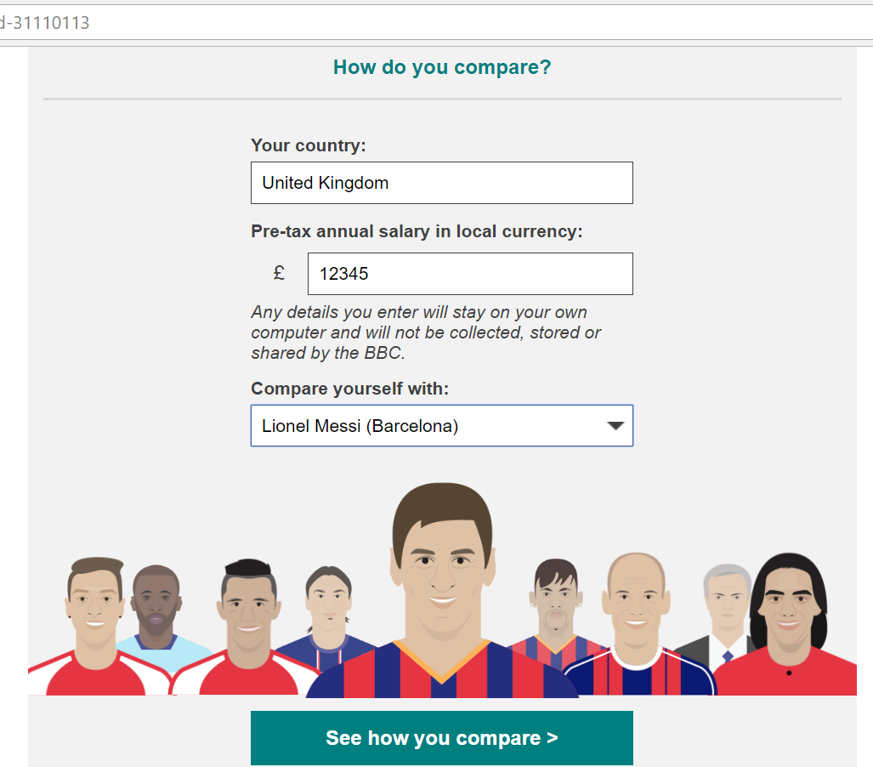
What is Dark Data?
It is an umbrella term, used to mean a number of different things.
One example it can refer to is ‘data leakage’.
BBC - footballer’s wages gaff on Twitter.
Amazon – deducing sales from publishing relevant position on other books
(A hat tip to Professor Mark Whitehorn!)

Slide 6

What is Dark Data?
Data that is being collected, but not being used.
“Information assets that organisations collect, process and store in the course of their regular business activities, but generally fail to use.” - Gartner
Customer comments on internet transactions – can you identify positive or negative sentiment without a feedback form?
Transaction logs – can you analyse your log files and predict when specific failures might occur?
Social media data – are you storing and analysing your network with more than intuition?

Slide 7
Why bother with Dark Data?
Data on its own isn’t valuable – data that can’t be analysed is worthless.
With new techniques and tools, semi-structured and unstructured data can be analysed to reap valuable new insights.
Dark data can provide potential new opportunities for customer analysis, performing predictive analytics and gaining a deeper understanding about your processes.
[Light Data + Dark Data = All Data]

Slide 8
Relational vs Non-relational

Slide 9


Relational databases overview
Advantages of relational:
Efficient, structured storage.
Keeps data consistent.
Complex querying language for retrieving data, updating, inserting, deleting.
Used for:
Modelling relationships between entities.
Reporting and decision-making.

Slide 10

Relational and NoSQL together
What can R do that SQL can’t?
Great for statistical analyses, machine learning, handling unstructured data.
Becoming a more general programming language.
Daily workload with R and SQL Server:
Structured, modelled data lives and is updated in SQL. Changes logged.
R is for ad hoc analyses on clean files, reshaping data files or reading non-flat files.
Quick to import, do a business analysis piece on, clean up and import, all in memory.

Slide 11
Microsoft and Data Science

Slide 12

What is R?
R is an open-source programming language, developed by academics and statisticians.
High level language, easy to learn.
Short development cycles.
Written in C, Fortran and R, so performance can be very fast.
Over 6,000 libraries available to use on CRAN.
Now used for cleaning data, ETL, data visualisation, maths, audio and visual analysis, machine learning etc.

Slide 13


Microsoft R
Formerly known as Revolution R
Provides Math Kernel Libraries (MKLs) capable of multithreading – makes R code generally faster.
MS offers three basic products:
R Open – a base
R Client – restricted use of proprietary functions.
R Server – unlimited scalability

Slide 14
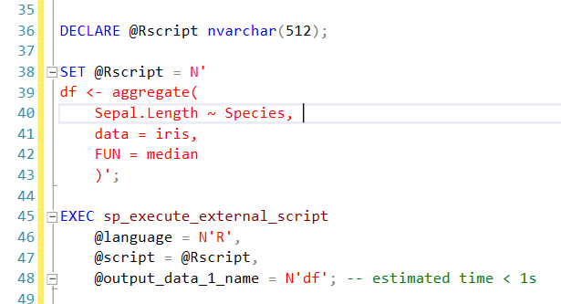
What’s new inside SQL Server 2016?
JSON support.
R and Microsoft R Server integration.
Other features:
Temporal tables.
Row masking and encryption.
Integration with Hadoop, Spark, Teradata.

Slide 15

UPDATE: Python in SQL Server 2017
No need to move data around.
Embed Python scripts inside T-SQL stored procedures.
You will therefore be able to deploy machine learning and AI applications inside SQL Server 2017.
Manage R and Python scripts in the same location.
90k+ libraries – majority of which should be compatible.

Slide 16
Dark Data in Microsoft R Server

Slide 17

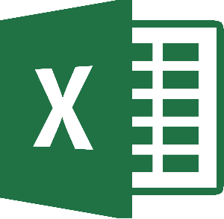







Slide 18




What do businesses use these tools for?
Building “data pipelines”:
New data is coming in all the time.
Needs to be extracted, transformed and loaded.
Needs to be fast.

Slide 19
Azure ML
Microsoft is constantly developing its Azure platform for data science and machine learning.
Tools:
Azure ML – a “drag and drop” tool for building data science pipelines.
Microsoft SQL Server 2016 with R Services – run R scripts as SQL procedures.
Microsoft R Server.
You also have Python support.
Build pipelines “without a PhD in statistics.”

Slide 20
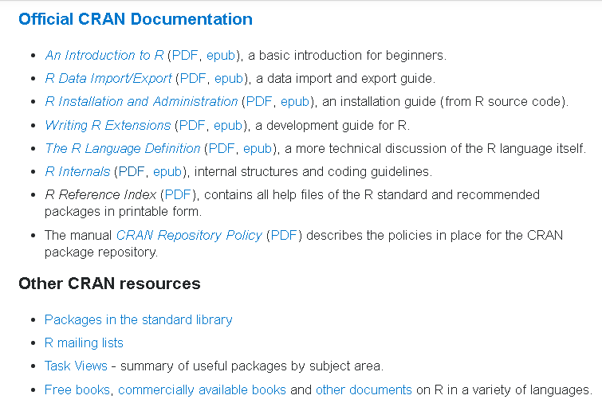
Resources
Stack Overflow:
Documentation Topics
Resources, books, tutorials
Consolidata:
R tutorial series
‘swirl’ library in R:
learn R inside R!

Slide 21
DEMOS

